Slide 1
Snapping Photos with a Superconducting Magnet
27 June 2016

Slide 2
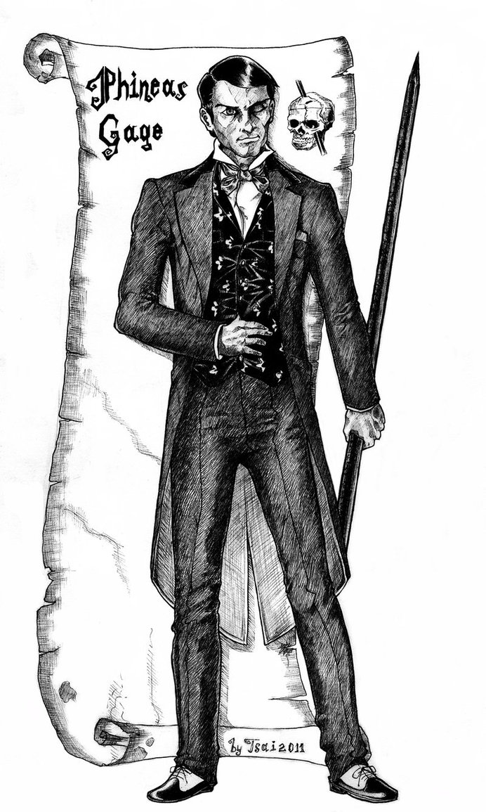
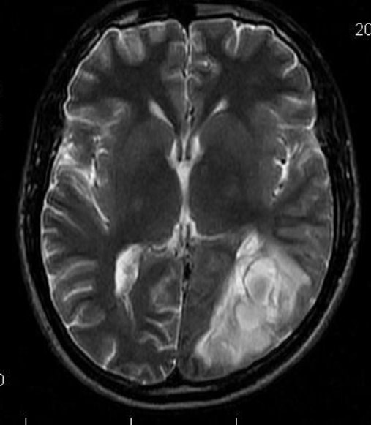
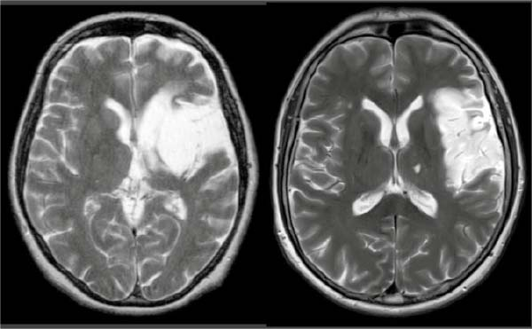
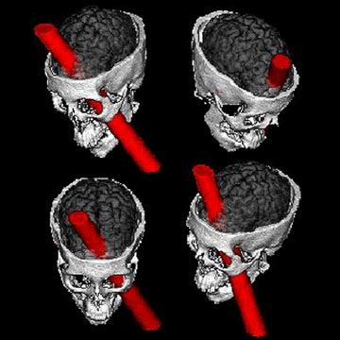
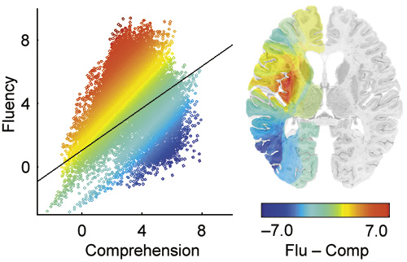
§ Tools we use in Neurocognitive Science
The good ol’ fashioned way
With a few modern advancements:
Clinical Measures - Lesion-Behavior-Relationship
Notes:
Used to define brain structures necessary to perform a cognitive function
Can also identify dissociations between cognitive functions
Correlate the area of injury with a change in behavior (e.g. aphasia)
Typically done when injury is chronic, to ensure stability
Limited by regularity of vasculature, reorganization after an injury, low n

Slide 3
§ Tools we use in Neurocognitive Science
Protons spin and have angular momentum
This also gives them a magnetic moment
Think of brain as bulk matter with anisotropic distribution of magnetic moments (from H₂0 atoms)
+
N
S
A moving charge creates a current, a current creates a magnetic field (and vice versa)
Physiological Measures - MRI
Notes:
Biological substrates – are they necessary for a particular cognitive function?

Slide 4
§ Tools we use in Neurocognitive Science
Protons spin and have angular momentum
This also gives them a magnetic moment
An externally applied magnetic field will
align the net magnetic moment in it’s own direction. They are still spinning – but out of phase with each other.
+
N
B
o
M_{o}
S
A moving charge creates a current, a current creates a magnetic field (and vice versa)
Physiological Measures - MRI
Notes:
Biological substrates – are they necessary for a particular cognitive function?

Slide 5
§ Tools we use in Neurocognitive Science
B
o
To generate an image, we want every proton aligned to the magnetic to emit a specific frequency of radiation that encodes it’s position defined within square area of limited resolution (i.e. 1 mm²).
This is accomplished by applying a rotating RF magnetic field B₁ into an orthogonal plane to B₀
The magnetiziation in B₁ precesses about B₀ at a frequency proportional to the strength of B₁
This precession creates a voltage in a receiver coil placed close to the head.
B
1
Larmor Frequency
Physiological Measures - MRI
Notes:
Biological substrates – are they necessary for a particular cognitive function?

Slide 6
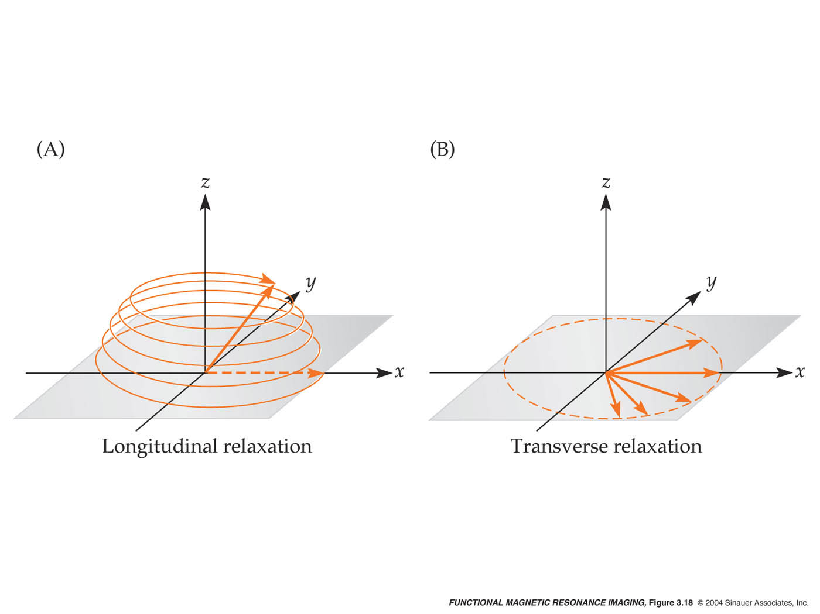

Slide 7
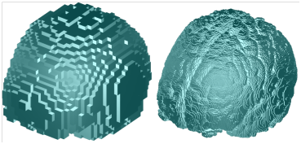
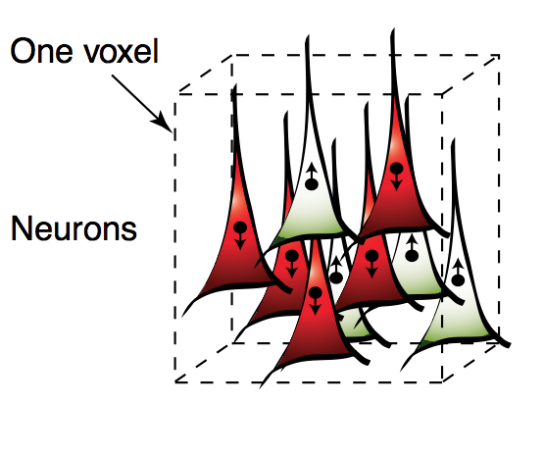
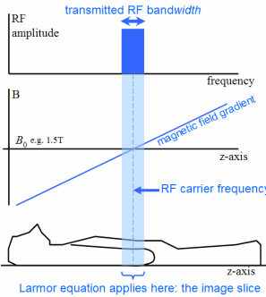
§ What is a voxel?
* RF pulse limited to a single slice at a time at coordinate z
* Each slice is a landscape where each x, y coordinate corresponds to a unique frequency of relaxation (due to a gradient magnetic field).
* The voxel is the fundamental limit of MRI resolution
Physiological Measures - MRI

Slide 8
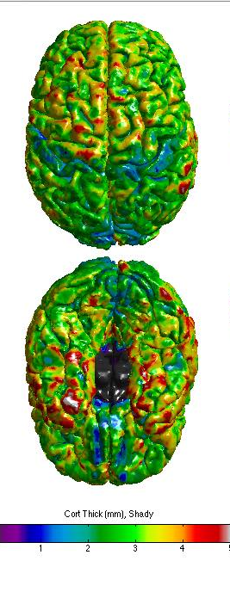
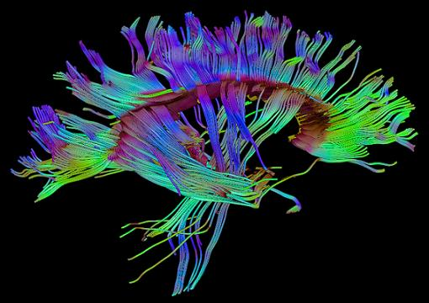
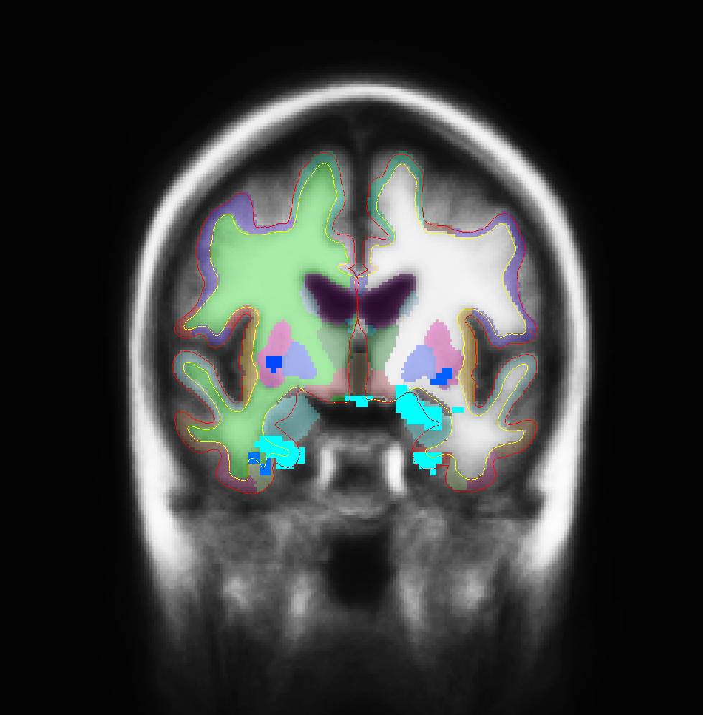
§ Tools we use in Neurocognitive Science
DTI
T1
T2
BOLD
Cortical Thickness
VBLM
Physiological Measures - MRI
Notes:
Biological substrates – are they sufficient for a particular cognitive function? Answer this with morphometric and functional techniques.

Slide 9
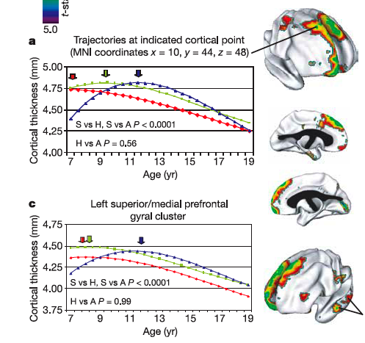
§ Tools we use in Neurocognitive Science
Separate gray and white matter
“Inflate” the brains (i.e. unfold)
Measure thickness of cortex
Again, what does it mean? Which layers? Cell bodies? Dendrites?
Physiological Measures - MRI: Cortical Thickness

Slide 10
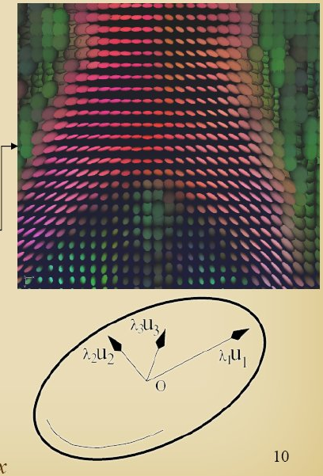
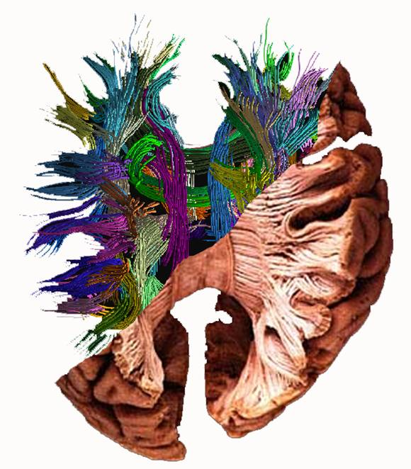
§ Tools we use in Neurocognitive Science
www.greyc.ensicaen.fr
Physiological Measures - MRI: Diffusion

Slide 11
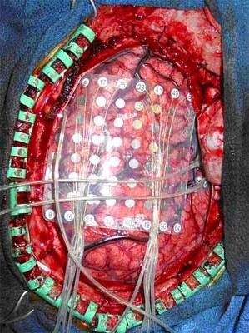

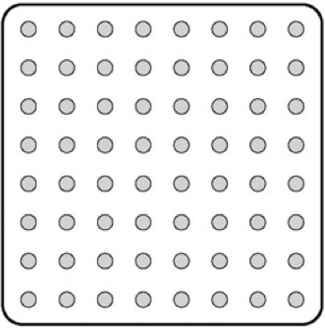
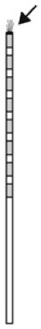
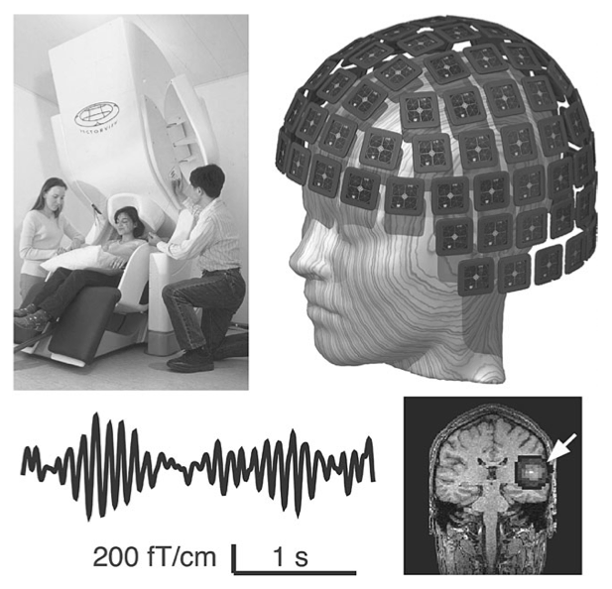
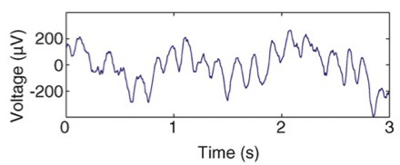
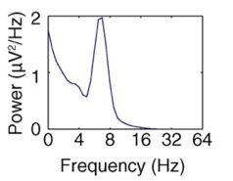
§ Tools we use in Neurocognitive Science
Physiological Measures - EEG, iEEG, MEG, PET
Notes:
Biological substrates – are they sufficient for a particular cognitive function? Answer this with morphometric and functional techniques.

Slide 12
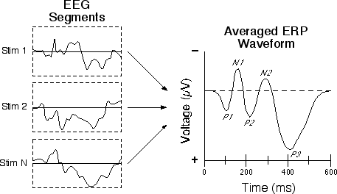
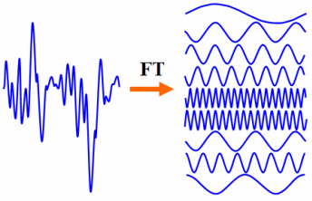
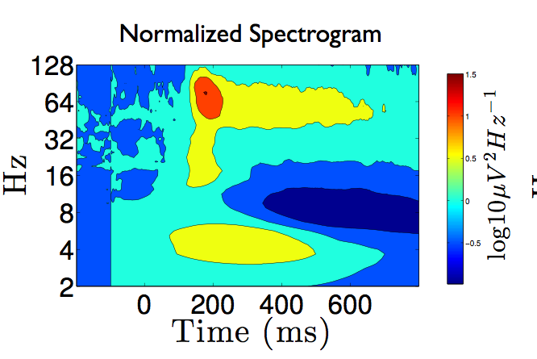
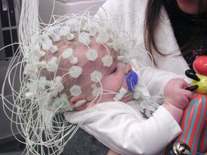
§ Tools we use in Neurocognitive Science
Event-related Potentials
Frequency Decomposition
Separating dependent variable in time
Separating dependent variable in time and frequency
Physiological Measures - EEG, iEEG, MEG
Notes:
What does time frequency analysis tell us about underlying structure?

Slide 13
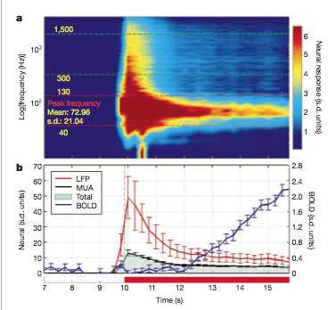
§ Tools we use in Neurocognitive Science
Physiological measures – MRI vs EEG/ECoG
Notes:
What does time frequency analysis tell us about underlying structure?

Slide 14
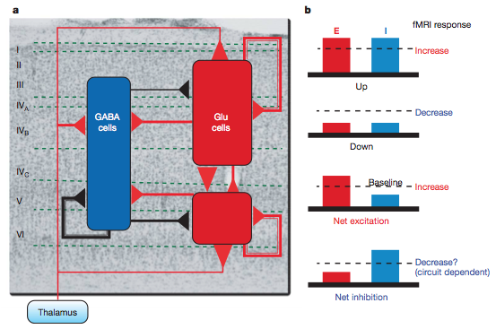
§ Tools we use in Neurocognitive Science
Physiological measures – Qs
Notes:
What does time frequency analysis tell us about underlying structure?

Slide 15
Functional MRI
Brain activity causes local hemodynamic changes
Local levels of oxy- and deoxy-hemoglobin change with brain activity
Oxy- and deoxy-hemoglobin have different magnetic properties
MRI echo planar images are sensitive to these magnetic properties- ~3 seconds for a whole brain
Oxygentation of hemoglobin is an “endogenous contrast agent”
Blood Oxygenation Level Dependent (BOLD) signal

Slide 16
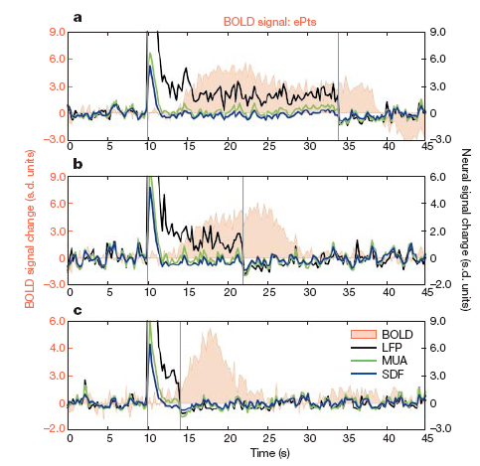
fMRI BOLD signal
BOLD is delayed and dispersed from neuronal activity
Reflects input to an area, and local intracortical activity
Does not quantitatively measure any specific physiologic value (e.g. blood flow, oxygenation)
Logothetis et al., 2001

Slide 17
Functional MRI
Advantages
Noninvasive
Very good spatial resolution (Can see ocular dominant columns, typically ~3-8 mm)
Very flexible for experimental design, analysis
Available at most research centers
Disadvantages
Not a direct measure of neuronal activity
Temporal resolution limited by hemodynamic response (~ seconds)
Very sensitive to subject motion
Noisy, artificial environment
Can’t tell if active areas are required for task performance

Slide 18
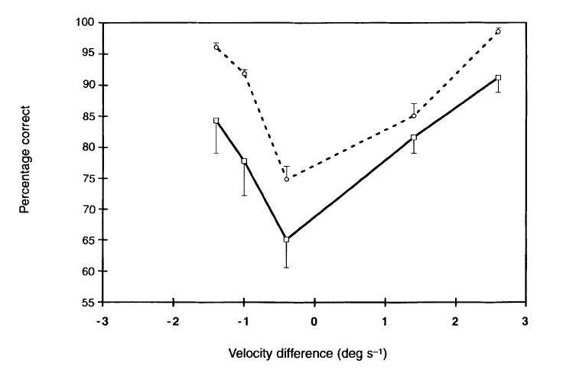
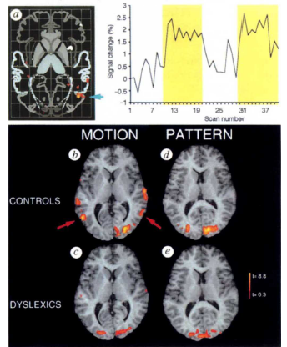
fMRI
Eden et al., 1996

Slide 19
Event-related fMRI
Church et al., 2008

Slide 20
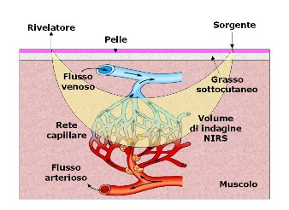
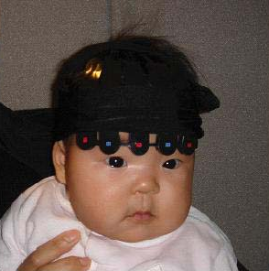
Near Infra-Red Spectroscopy
Low spatial resolution, measures blood oxygenation, limited to cortical surface, but noninvasive, can measure continuously

